Slide 1

Coordinated Highways Action Response Team
Estimation of Incident duration in real time for I-95
Instruction for Incident prediction program
Traffic Safety and Operation Lab
Dept. of Civil and Environmental Engineering
University of Maryland, College Park
Office of CHART & ITS Development
Maryland State Highway Administration

Slide 2
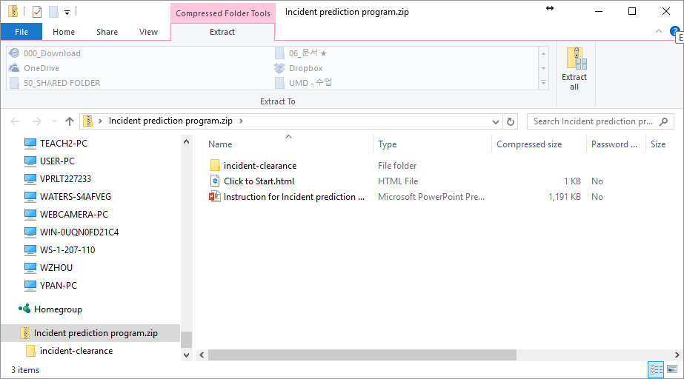
Preparation for program
Double click "Incident prediction program.zip" file
Click "Extract all" button

Slide 3
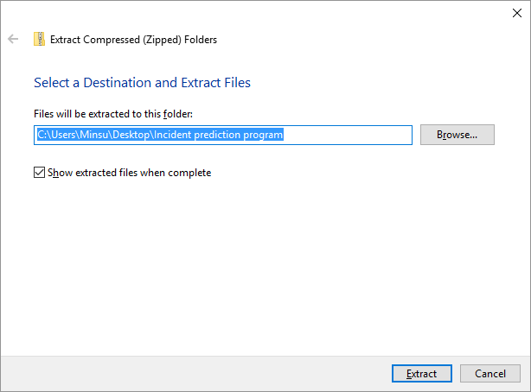
Preparation for program
Choose a destination you want to extract files
Click "Extract" button

Slide 4
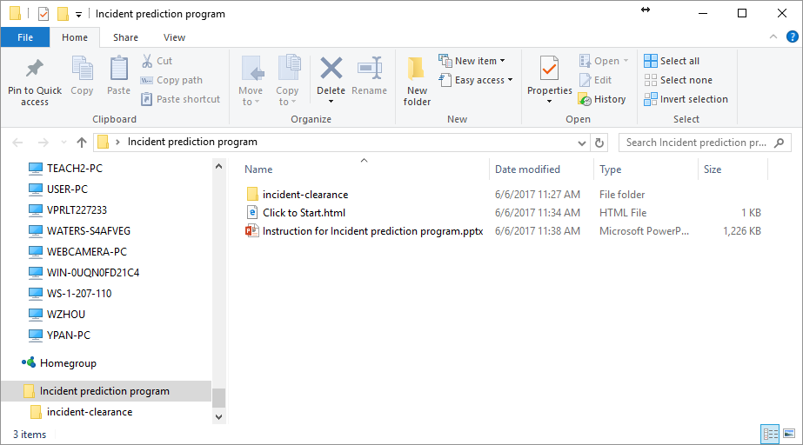
Program execution
Double click "Click to Start.html" file to start

Slide 5
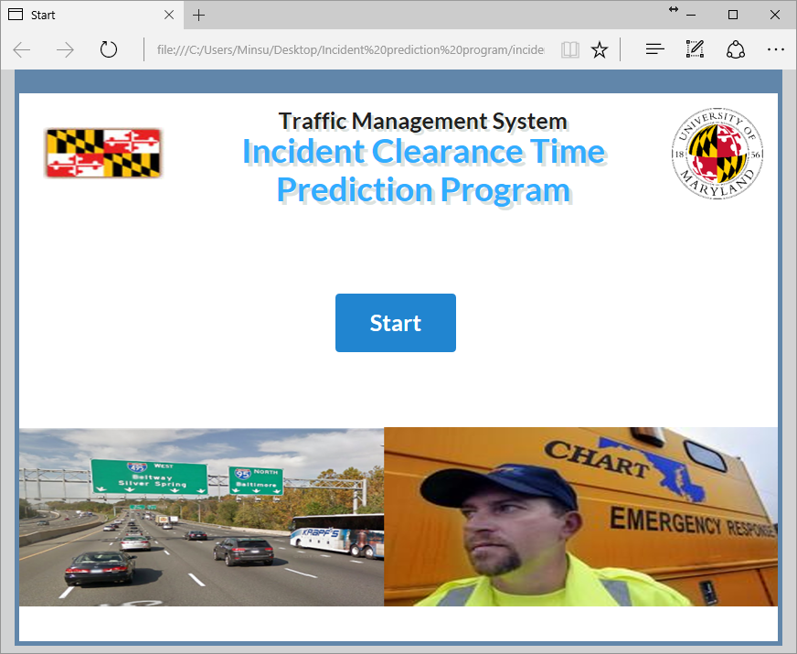
Program execution
Click "Start" button
Follow the on-screen instructions to estimate incident clearance time

